Slide 1
DW Assignment 2 Presentation
Radchanon Don Sukkram

Slide 2
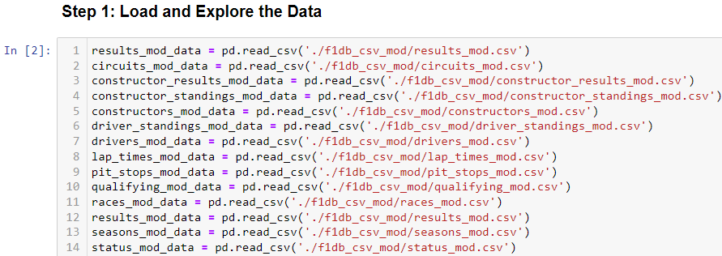
Load Data

Slide 3
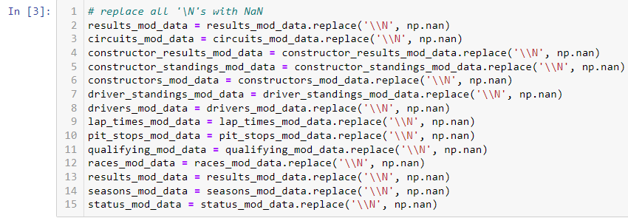
Check For Null Values
Replaced all ‘\N’ values with NaN

Slide 4
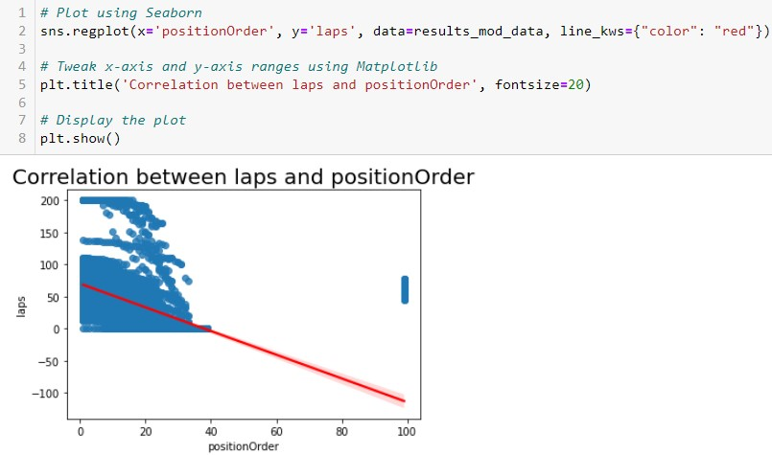
Data Exploration: Correlation (laps, positionOrder)
Negative Correlation between laps and positionOrder
As laps decreases, positionOrder increases.

Slide 5
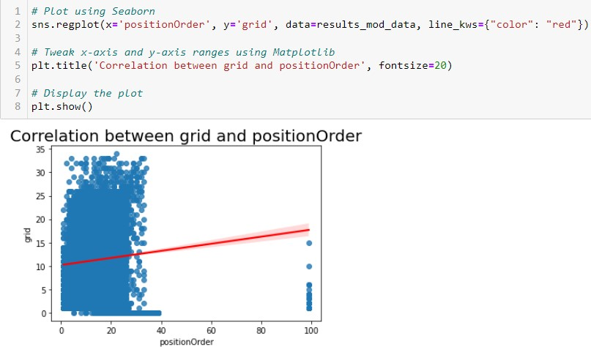
Data Exploration: Correlation (grid, positionOrder)
Positive Correlation between grid and positionOrder
As laps increases, positionOrder increases.

Slide 6
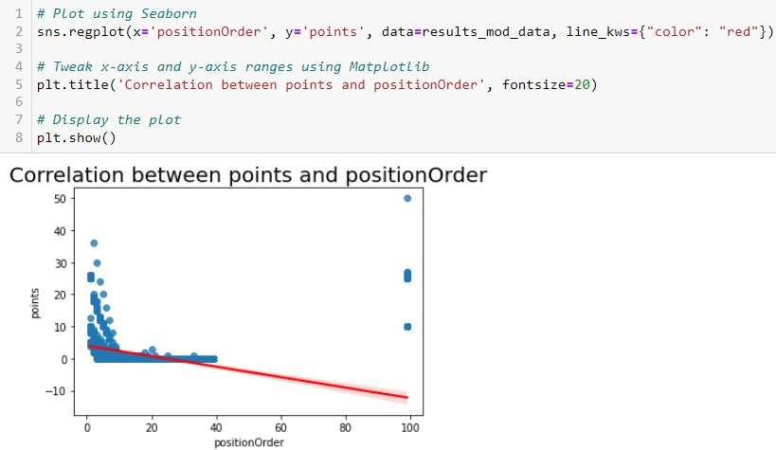
Data Exploration: Correlation (points, positionOrder)
Negative Correlation between points and positionOrder
As points decreases, positionOrder increases.

Slide 7
Prediction Problem
Predict if the drivers will be in the Top 5 positions

Slide 8
Merging Tables
Data = Results Table + Drivers Table + Races Table + Circuits Table + Constructor Table

Slide 9
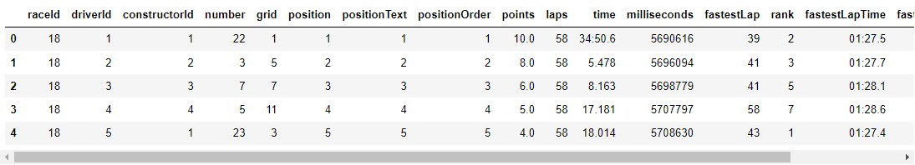
Results Table
Remove the resultId column
Reason: Does not add value when predicting the winner

Slide 10
Merging Tables
Data = Results Table + Drivers Table + Races Table + Circuits Table + Constructors Table

Slide 11
Merge Drivers Tables
Merge Columns: driverId, dob, nationality, url
Merge Table on driverId
Remove Columns

Slide 12
Merging Tables
Data= Results Table + Drivers Table + Races Table + Circuits Table + Constructors Table

Slide 13
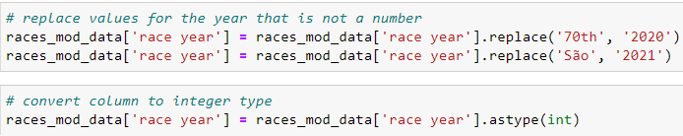
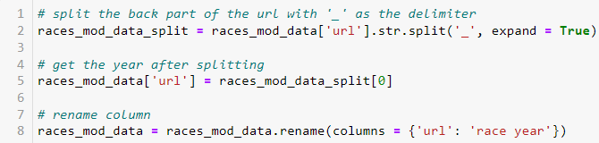
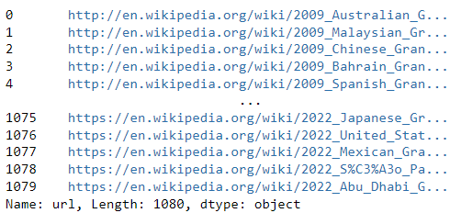
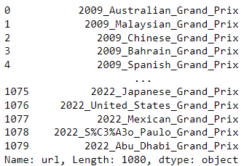
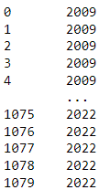
Merging Races Table
Get year of the race

Slide 14
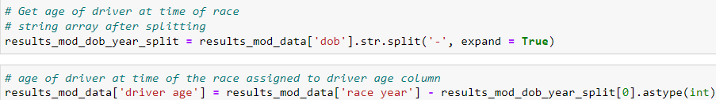
Calculate Age of Driver
Split the date of birth
Using ‘-’ as the delimiter
Convert to Int

Slide 15
Merging Tables
Data = Results Table + Drivers Table + Races Table + Circuits Table + Constructors Table

Slide 16

Merge Circuits Table
Merge Circuits Table with Results Table
Add Columns: circuitId, alt
Merge on circuitId
Convert data type to int: alt column

Slide 17
Merging Tables
Data = Results Table + Drivers Table + Races Table + Circuits Table + Constructors Table

Slide 18
Merge Constructors Table
Merge Constructors Table with Results Table
Add columns: constructorId, name
Merged on: constructorId
Rename column: name → constructor name

Slide 19
Add Target Column
Added a column: top 5
Binary column
1 → Top 5
0 → Not Top 5
If the position of the driver is less than or equal to 5,
then 1
, else 0

Slide 20
Remove Unnecessary Information
'points', 'positionText', 'positionOrder', 'raceId', 'constructorId', 'circuitId', 'statusId, 'dob'
Due to direct correlation
Unnecessary

Slide 21
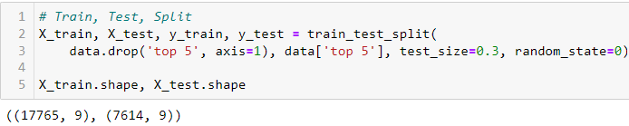
Train Test Split

Slide 22
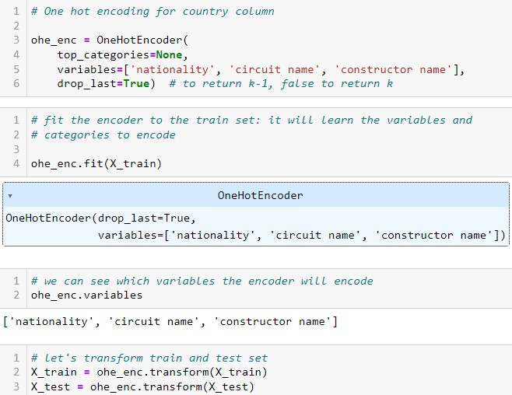
One-Hot Encoding
Used Feature Engine
One-Hot Encoding

Slide 23
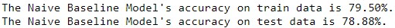
Results of Baseline Classification Model

Slide 24
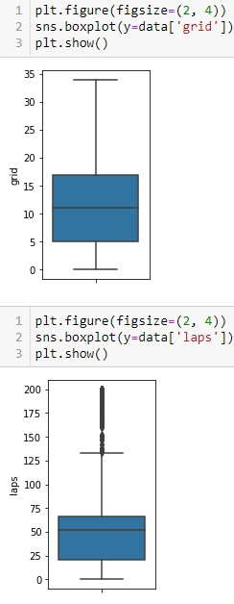
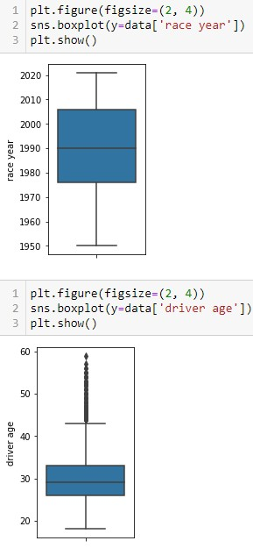
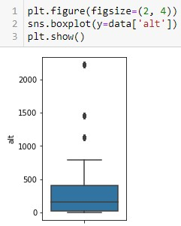
Check for Outliers
Variables with Outliers:
laps
driver age
alt

Slide 25
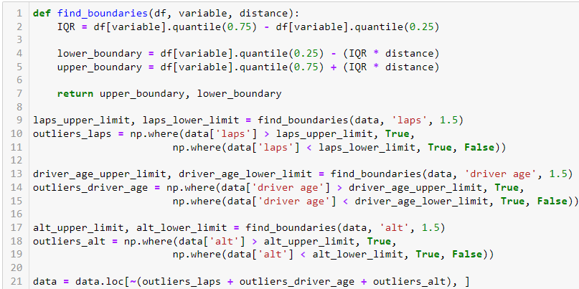
Deal with Outliers
Methods Tried:
Trimming
Windsorization
The final method chosen: Trimming
Reason: Better result

Slide 26
Numerical Data Transformation
Methods Tried:
- YeoJohnson Transformer
- Logarithmic Transformer
- Reciprocal Transformer
- Power Transformer
- SquareCubeRoot Transformer
- BoxCox Transformer
Reason: Best Result

Slide 27
Encoding Categorical Variables
Method of choice: One Hot Encoding
Main Methods considered:
- Label or Ordinal Encoding
Add unnecessary bias
Model prioritises larger numbers and sees them as more important compared to smaller numbers
Model not accurate and not reliable
- Count or Frequency Encoding
Different categories appear the same number of times
Different categories will be represented by the same value
Model not accurate and not reliable
- Target or Mean Encoding
Many categories will be represented with 0
Some categories did not win, hence the mean will be 0 for these categories
Different categories will be represented by the same value
Model not accurate and not reliable

Slide 28
Variable Discretization or Binning
Method of choice: Equal Frequency
- Produced the best result
Other method tried: Equal Width
- Did not produce as good of a result

Slide 29
Feature Scaling
Standard Scaler
MinMax Scaler
Mean Normalisation
MaxAbs Scaler
Robust Scaler

Slide 30
Final Model

Slide 31
Thank You

